Slide 1
JavaScript & Bootstrap BFF

Slide 2
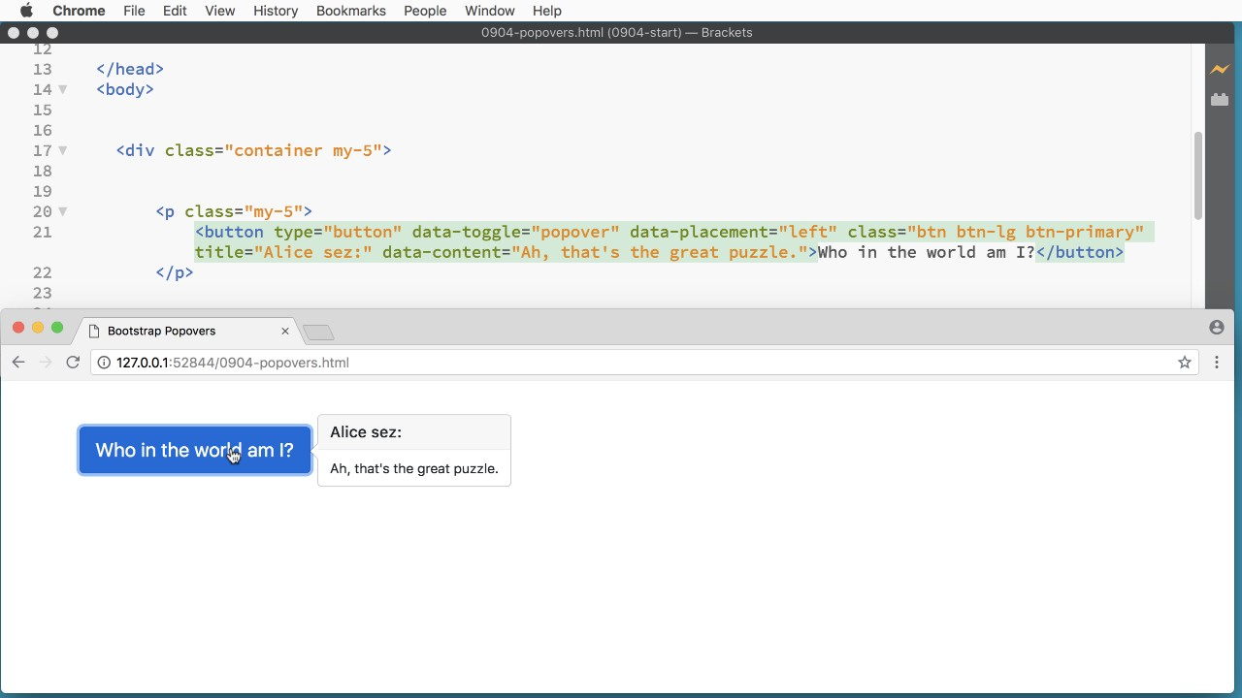

Slide 3
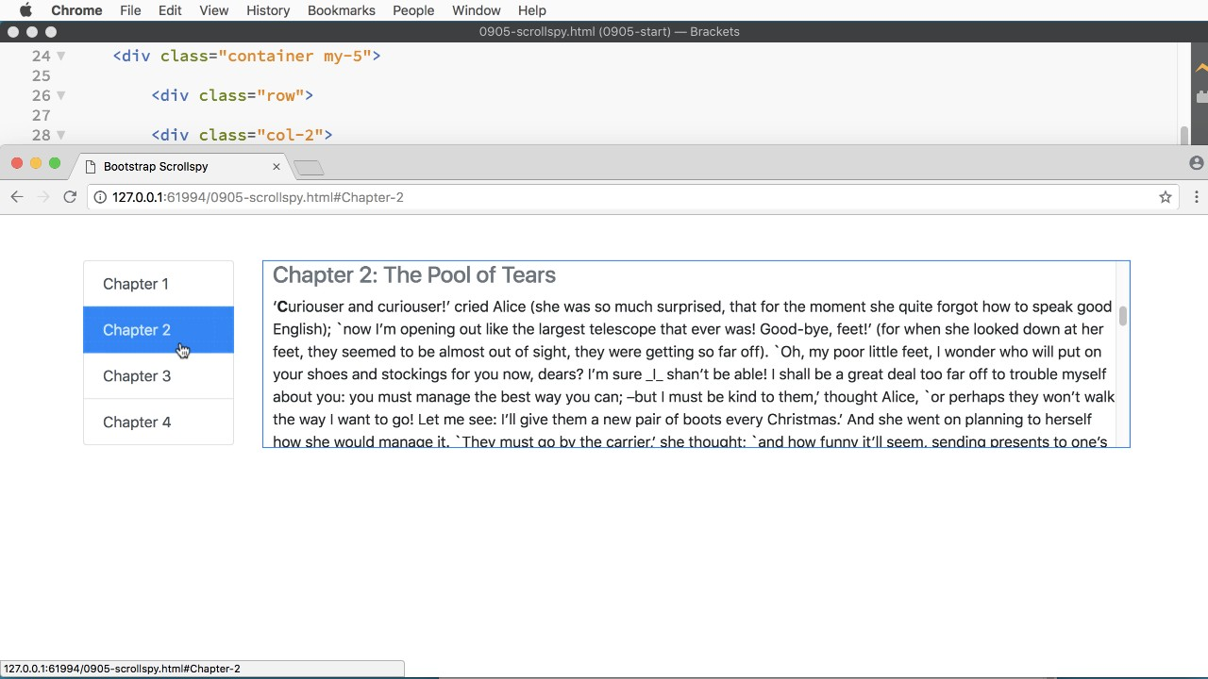

Slide 4
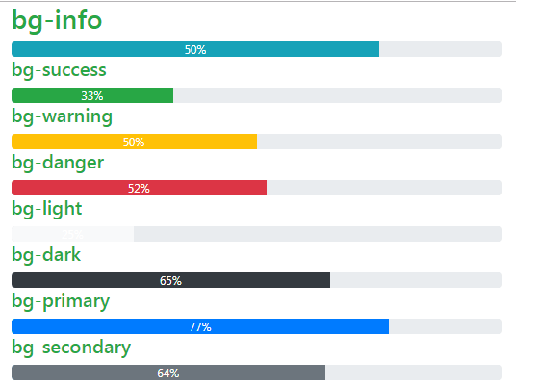

Slide 5
Let's get started.

Slide 6
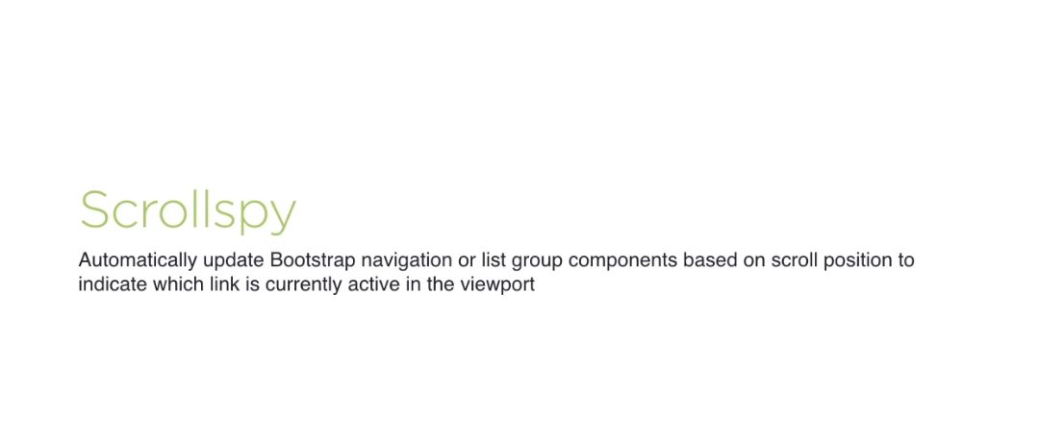

Slide 7
Summary

Slide 8

Summary

Slide 9
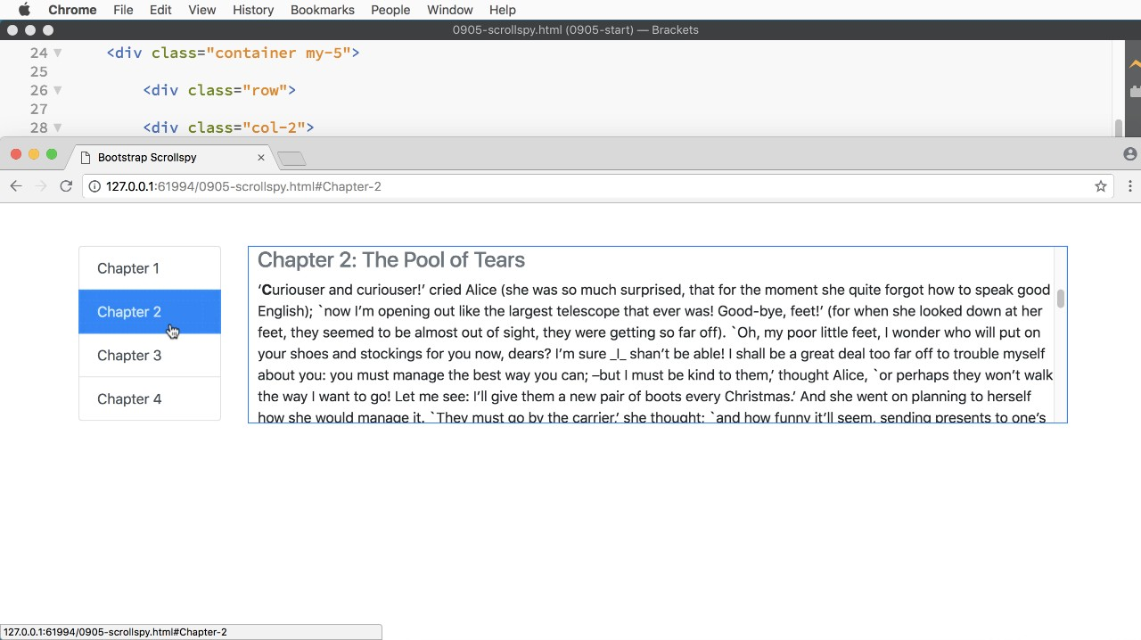
Summary

Slide 10
Summary

Slide 11


